Slide 1
Taking Dynamics CRM Beyond Accounts and Contacts

Slide 2
Agenda
Welcome
Introductions
Class
Wrap-up

Slide 3

Your Instructor
Mitch Milam
mitch@xrmcoaches.com
@mitchmilam
blogs.infinite-x.net
xrmcoaches.com
crmaccelerators.net
Rockmycrm.com

Slide 4
Introductions
Please introduce yourself, including:
Your name
Your company
Your role
Which version of Dynamics you use
One of your objectives for today’s class

Slide 5
Logistics
Class schedule and break(s)
A class survey will be available online at the survey kiosks
CPE credit may be requested via the class survey

Slide 6
Agenda
Streamlining the CRM 2011 user experience
Reporting basics
Using Charts and Dashboards
Marketing and Lists

Slide 7
Streamlining the CRM 2011 User Experience
User experience quick-tips
Recording the right data
Creating a custom activity
Modifying the data entry forms
Customizing views

Slide 8
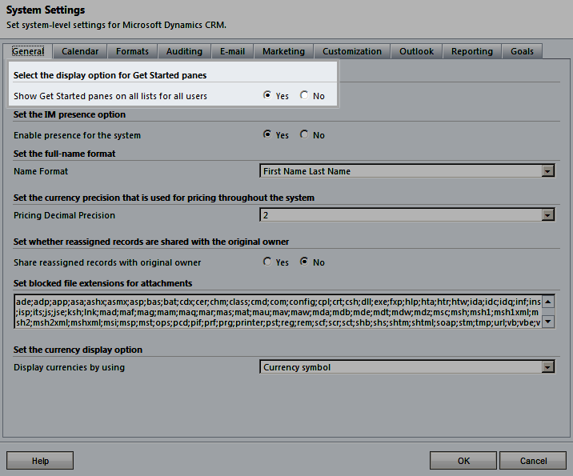
CRM User Experience Quick-Tips
Turn off the Getting Started Panes

Slide 9
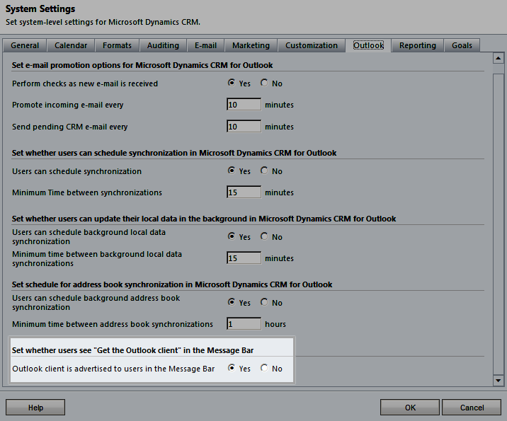
CRM User Experience Quick-Tips
Turn off Get the Outlook Client Message

Slide 10
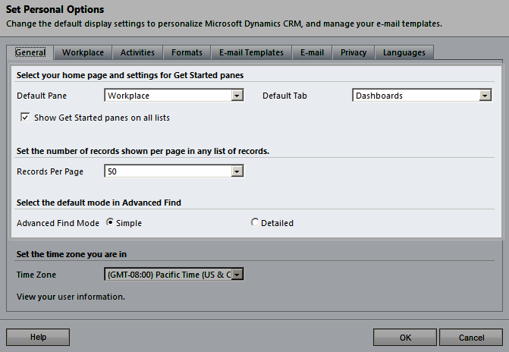
CRM User Experience Quick-Tips
Setting Personal Options

Slide 11
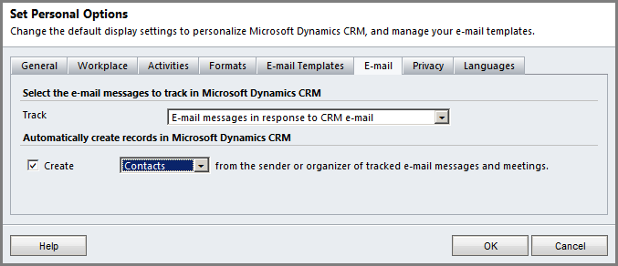
CRM User Experience Quick-Tips
Setting Personal Options

Slide 12
Recording the right data
What is the right data?
Are you capturing the proper interactions with your customers?
Are you maintaining Institutional Intelligence?

Slide 13
Custom Activities
What are custom activities?
How are they used?
Examples:
Download Request
License Installation
Product Purchase
Webinar

Slide 14
Exercise: Custom Activities
Create a Webinar custom activity

Slide 15
Modifying Data Entry Forms
Remove unused form fields
Make required fields required
Group required fields, as much as possible
Collapse tabs
Put iFrames in their own tab
Collapse the tab, if possible

Slide 16
Exercise: Modifying Data Entry Forms
Clean up the Contact form
Publish changes
Review your work

Slide 17
Example: Modifying Data Entry Forms
Standard Contact form load time
Perceived Load Time (read/scroll ready) 4,148
Full Load Time (edit ready) 5,445
Modified Contact form load time
Perceived Load Time (read/scroll ready) 3,462
Full Load Time (edit ready) 4,666
Savings of .80 seconds per operation
.80 * 50 users * 100 records = 4,000 seconds
66.67 minutes per day

Slide 18
Exercise: Modifying Data Entry Forms
Edit the customertypecode
Add the following values
Customer
Partner
Vendor
Prospect
VIP
Add the field to the form
Publish changes

Slide 19
Views: Are they working?
What is the Default View?
Does it have the necessary fields?
Are people using many Personal Views?
Do you get requests for change often?

Slide 20
Streamlining the User Experience
Questions

Slide 21
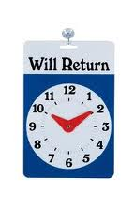
On a break
Be right back

Slide 22
Report Basics
What is a report?
What to report
When to report
How to report

Slide 23
What is a Report?
Wikipedia:
A report is a textual work (usually of writing, speech, television, or film) made with the specific intention of relaying information or recounting certain events in a widely presentable form.
Reports such as graphics, images, voice, or specialized vocabulary in order to persuade that specific audience to undertake an action.

Slide 24
What is a Report in CRM
Raw data
Lists
SQL Reporting Services Reports
Summary data
SQL Reporting Services Reports
Charts and statistics
Visualizations
Dashboards

Slide 25
When to Report
Scheduled
Daily
Weekly
Monthly
Quarterly
Annually
On-demand
Real-time

Slide 26
How to Report
System view or advanced find
Excel
Charts
Dashboards
SQL Reporting Services Report

Slide 27
Interactivity
Does the report need to be interactive?

Slide 28
Identify Your Audience
Executive Level
Managers
Worker bees

Slide 29
Identify Their Requirements
What do they need to see
When do they need to see it
What form does it need to be in

Slide 30
Interactive Demonstrations
Creating a basic report
Exporting data to Excel

Slide 31
Reporting
Questions?

Slide 32
On a break
Be right back

Slide 33
Charts and Dashboards
Review Charts
Create a Chart
Review Dashboards
Create a Dashboard

Slide 34
Charts
Where can charts be used?
Who can create them?
What can they show me?

Slide 35
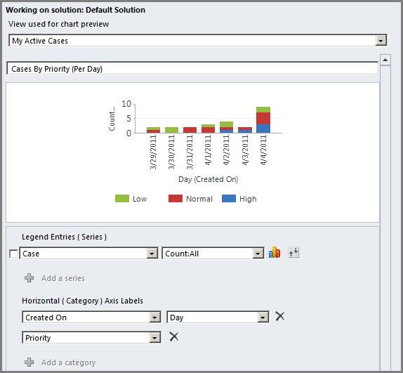
Chart Example

Slide 36
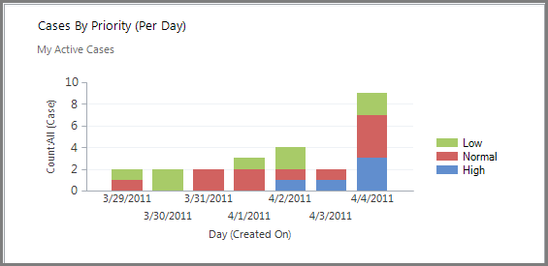
Chart Example

Slide 37
Charts Exercise
Create a chart

Slide 38
Dashboards
What is a dashboard?
Who needs dashboards?
Review standard dashboards

Slide 39
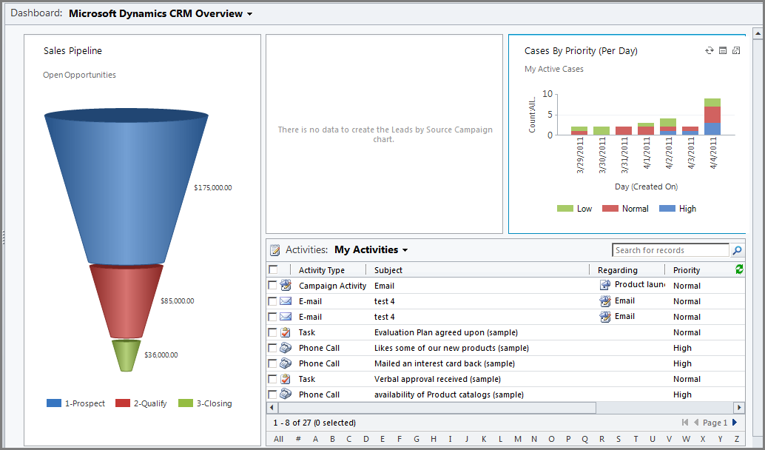
Dashboard Example

Slide 40
Dashboard Components
Dashboard Layout
Controls
Charts
Lists
Web Resources
iFrames

Slide 41
Dashboard Exercise
Creating a dashboard

Slide 42
Charts and Dashboards
Questions?

Slide 43
On a break
Be right back

Slide 44
Marketing and Lists: Questions
Who uses Marketing Lists and how?
Who has third-party marketing software?
Click Dimensions
CoreMotives

Slide 45
Definitions
What is a Marketing List?
Marketing List Types
Static
Dynamic

Slide 46
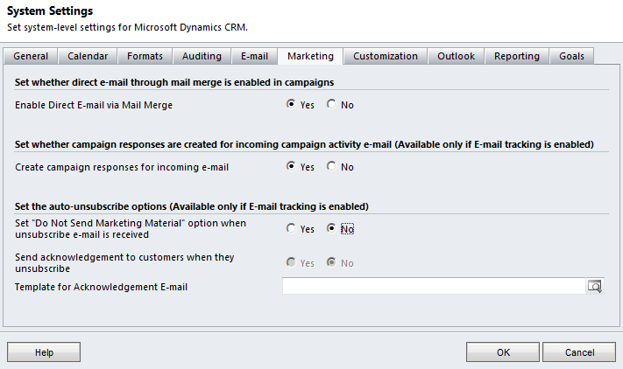
System Settings

Slide 47
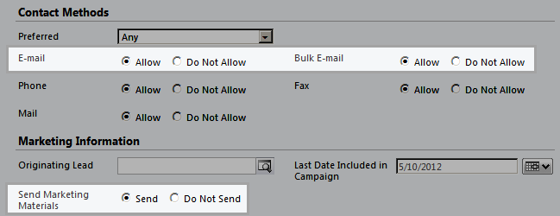
Contact Settings

Slide 48
Interactive Demonstrations
Create a Marketing List
Static
Dynamic
Sending Quick Campaign Email to a Marketing List

Slide 49
Marketing and Lists - Quick-Tip
Add the Members Count field to the Marketing List view
Allows you to verify the number of members
Is only valid for Static Marketing Lists

Slide 50
Wrap-up
Thanks for joining us!
Fill out class evaluations (at kiosks)
Request CPE credit via evaluation
Enjoy the conference

